Slide 1
Lead Your Own Team Booking Blitz!
Erin Bartley, SESL

Slide 2
Leadership Conference Workshop
Increase Team Bookings Panel
Consultant Office > Training > Conference Workshops > Increase Team Bookings Panel

Slide 3
Meet Erin Bartley, SESL

Slide 4
Why Do Your Own Team Booking Blitz?
New Consultants benefit!
Great for team members who want to re-start!
Team learns resiliency.
You create a booking team culture.
Team parties are booked! On average…

Slide 5
Numbers Tell A Story
Started monthly booking blitzes in January 2018 as part of a plan to promote to SESL = My team had stalled.
I had 20-30 active consultants and group sales of $11,000.
First blitz = 4 Consultants joined the blitz!
June 2018 = I had 75 engaged consultants and $40,000 in group sales.
December 2018 Booking Blitz = 28 attended with 40 parties booked.
CURRENT = I have a blitz planned for Sunday - 30 Consultants have clicked they’re participating!

Slide 6
How Do You Set Up a Team Booking Blitz?
Create Blitz on a Team Event page.
Post same/similar instructions for every post.
Walk through process of preparing for bookings.

Slide 7
Sell the Benefits!

Slide 8
What Mindset Do YOU Have?

Slide 9
FRANKI List
Update FRANKI List
Reward with prizes
List 5 people in each category
Number people
3 = Definitely YES!
2 = No idea
1 = Definitely No

Slide 10
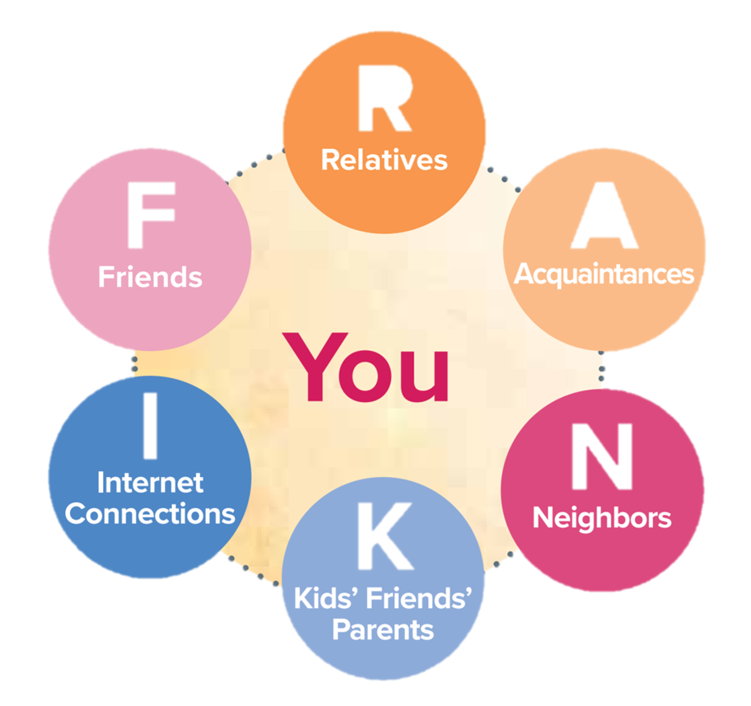
FRANKi List!
Grab all past party Customer Order Forms – highlight from each party, the person who bought the most, bought the least, you liked to the most, etc.
Go through your calendar and note all past cancellations or rescheduled Hosts to rebook.
Grab your FRANKI List and ongoing list of people who have been telling you they’d like to have a party.

Slide 11
Look at calendar and create goals.

Slide 13
Scripts!
Hey ______! I don’t know if you know yet or not, but I’ve recently started selling Norwex! I’m hoping to get a few demos on my calendar to get off to a good start. Would you be willing to help me out?
Hey_____! I know you love your products from _____'s demo so I wanted to see if you would be interested in sharing these products with your own friends and family at your own Norwex demo. My average host earns $200-$400 in totally free items!

Slide 14
Scripts—Part Two!
Hey ______! You were really involved in ______’s party and really seemed interested in a lot of the products. Would you be interested in hosting a demo to show your friends and family how Norwex works? The hostess benefits this month are AWESOME - and as usual- completely free!
Hey _____ have you heard of Norwex? I love the products because they clean like nothing else - using only water! I liked them so much I joined as a Consultant for the company. Would you consider hosting a demo so I could show you and others how it works?

Slide 15
Post to Begin the Blitz ~

Slide 16
Post At End of Blitz ~

Slide 17
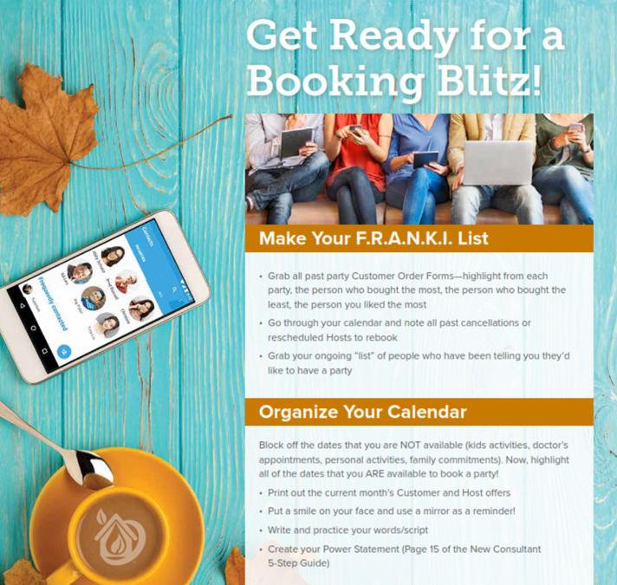
When Norwex Has One, Use IT!

Slide 18
Team Follow-Up
Teach them how to follow up with the “maybe" and "no” responses.
Teach new Consultants to follow up and then, know how to Host Coach.

Slide 19
Things I Learned Along The Way…
Break the blitz down into baby steps produces better results.
THREE phases –
Prep
Blitz
Follow up
First, hold team meeting, then few days later hold Booking Blitz!
Consistently doing the blitz every month is key.
Have realistic expectations and commit to a six month trial period.
Make the blitz part of your new consultant training - they can attend and watch even if they don't book.
Personally reach out to new Consultants and ask them to participate.

Slide 20
We Challenge YOU~
Set Team Booking Blitz date in April to be held within the next week.
Lead Your Own Team Booking Blitz recording:
Training > Book > More Booking Ideas
Set Team Booking Blitz in May, June and July (few days after your Team Meeting).
Set Team booking goal.
Invite team members; personally invite new Consultants.
Follow Erin’s steps:
Prep, Blitz, Follow-Up!

